Slide 1

Employee Management System

Slide 2

EMPLOYEE MANAGEMENT SYSTEM
By :
Kondaveeti sainikhitha
Arroji Venkatesh
Mercy rayanthula

Slide 3

INTRODUCTION
✅ Efficient Employee Information Management
Centralize and manage all employee personal and job-related details in one system.
💼 Streamlined Job and Department Assignment
Accurately assign employees to roles and departments for better organizational structure.
💰 Automated Payroll Processing
Calculate salaries, bonuses, and deductions automatically based on job roles and leave records.
📚 Qualification and Skill Tracking
Maintain records of employee qualifications to ensure role eligibility and enable growth planning.
🗓️ Effective Leave Management
Track employee leaves and ensure accurate payroll adjustments based on leave history

Slide 4
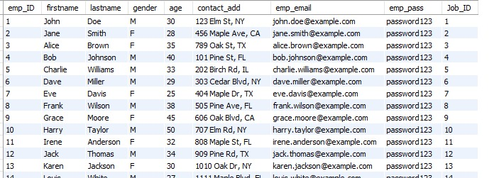
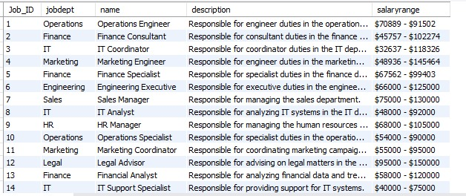
TABLES
Employee table
Jobdept table

Slide 5
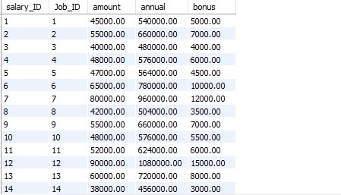
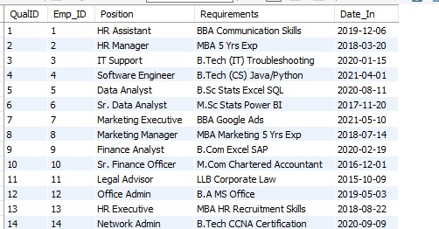
Salarybonus table
Qualification table

Slide 6
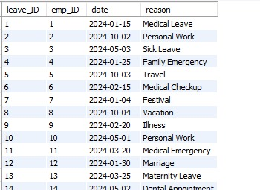
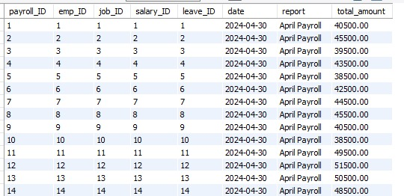
Leaves table
Payroll table

Slide 7
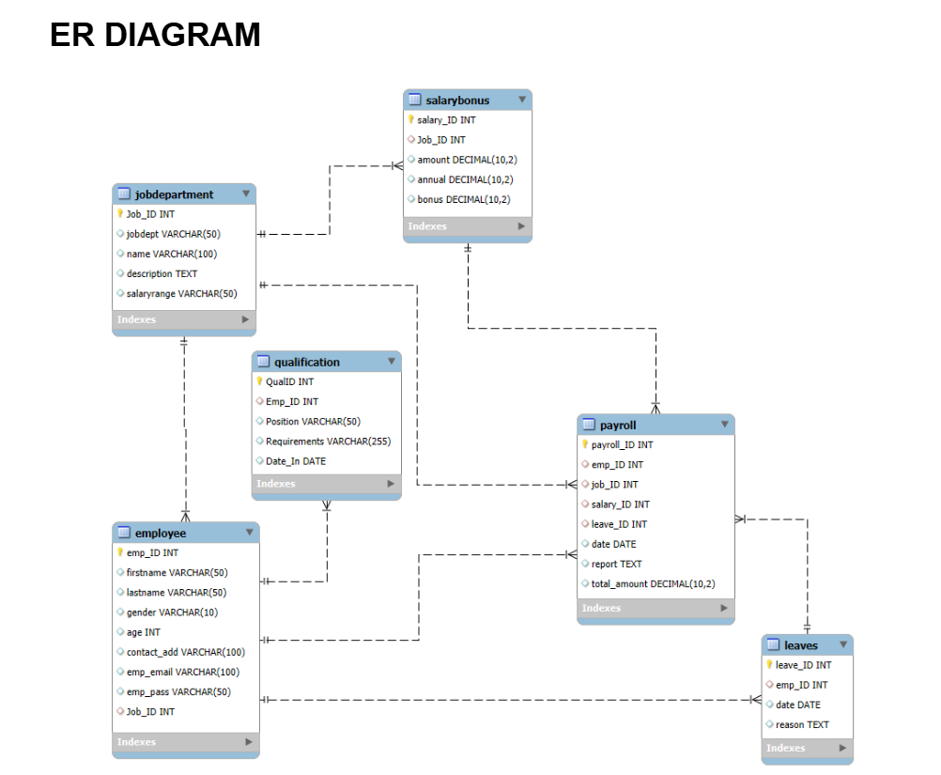

Slide 8
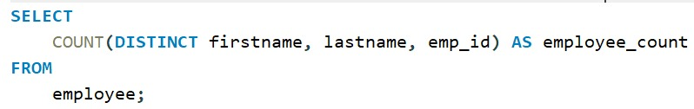

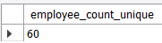
1. How many unique employees are currently in the system?

Slide 9
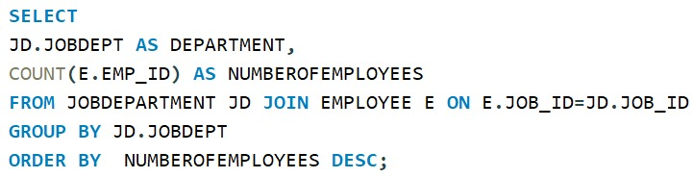

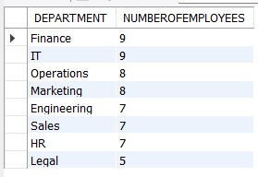
2. Which department have the highest number of employees?

Slide 10
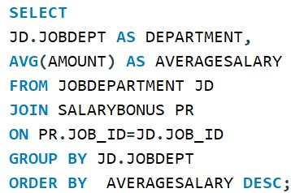

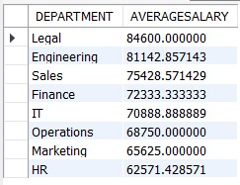
3. What is the average salary per department?

Slide 11
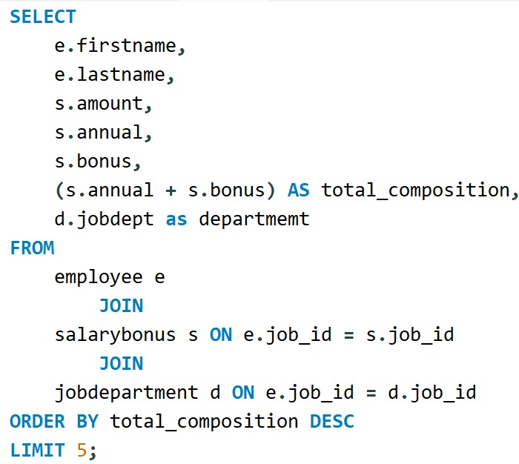

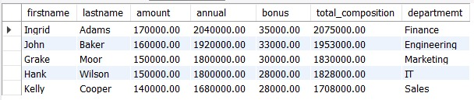
4. What are the top 5 highest-paid employees?

Slide 12
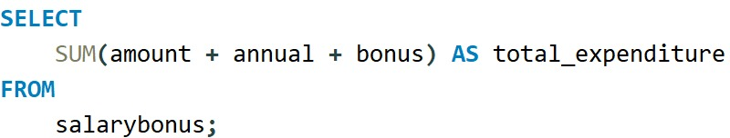
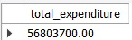
5. What is the total salary Expenditure across the company?

Slide 13

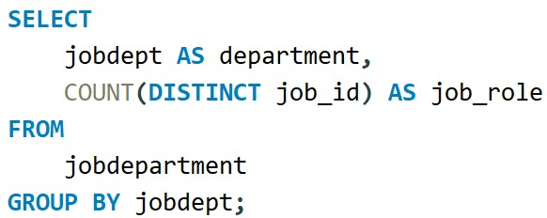
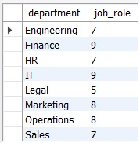
6. How many different job roles exist in each department?

Slide 14
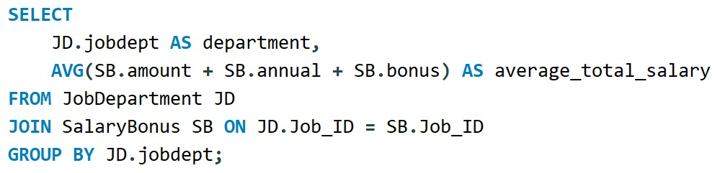
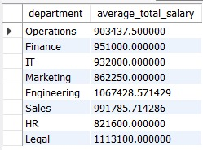
7. What is the average salary range per department?

Slide 15
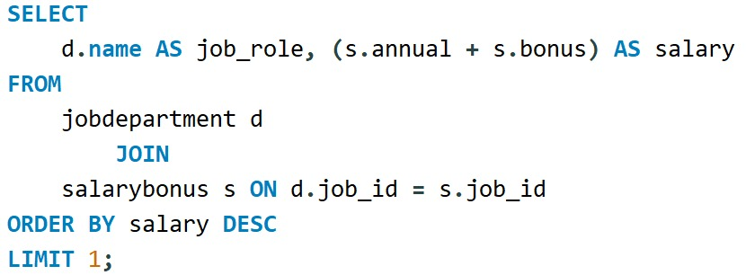
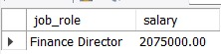
8. What job roles offer the highest salary?

Slide 16
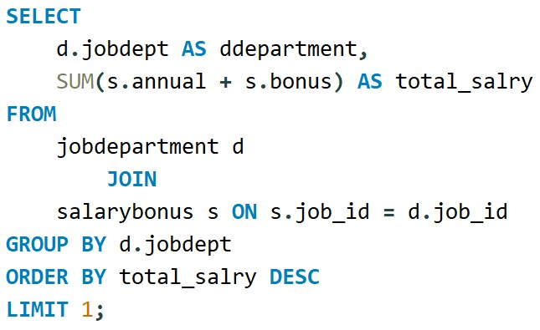
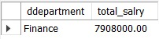
9. Which department have the highest total salary allocation?

Slide 17
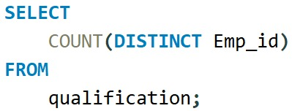

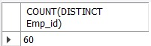
10. How many employees have at least one qualification listed?

Slide 18
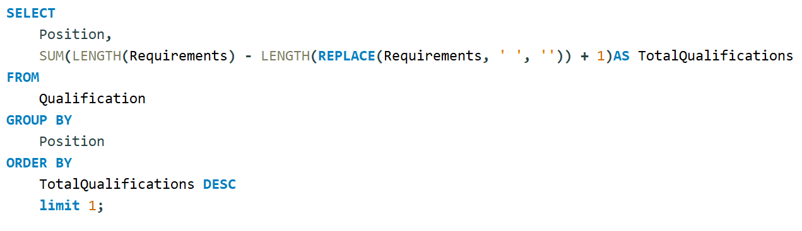

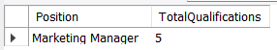
11. Which positions require the most qualifications?

Slide 19
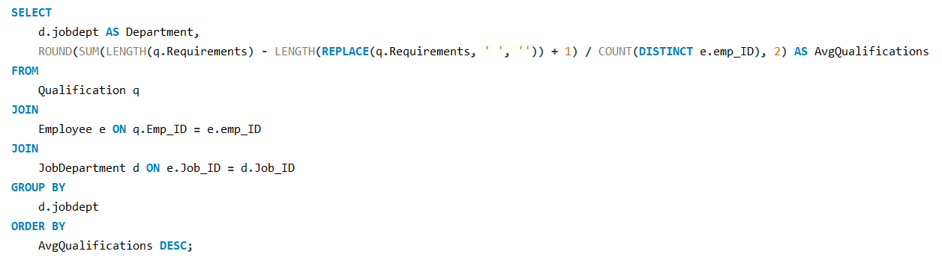
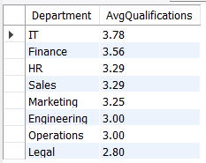

12. What is the average number of qualifications per department?

Slide 20

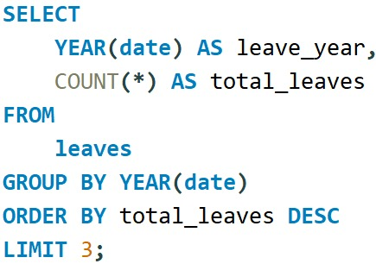
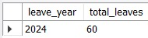
13. Which year had the most employees taking leaves?

Slide 21

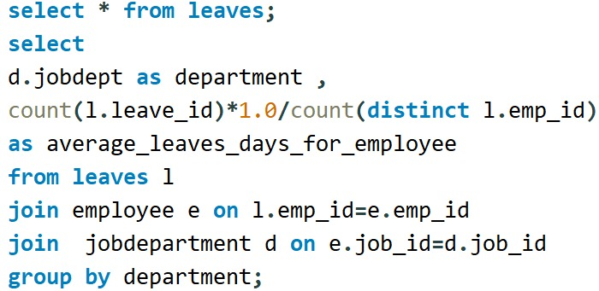
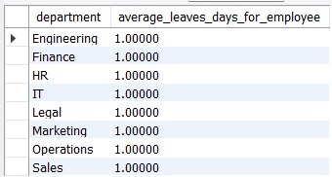
14. What is the average number of leave days taken by its employees per department?

Slide 22
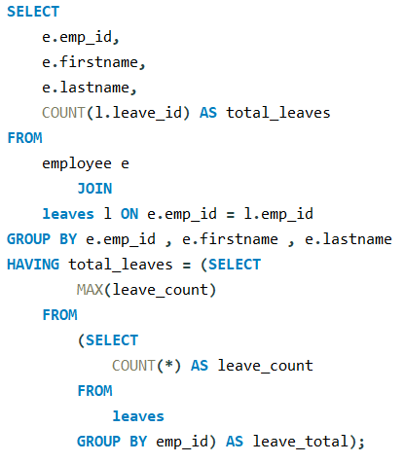

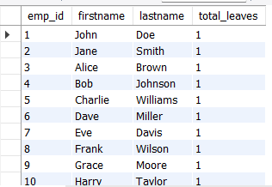
15. Which employees have taken the most leaves?

Slide 23
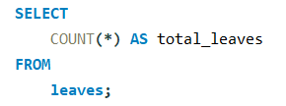

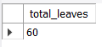
16. What is the total number of leave days taken company-wide?

Slide 24

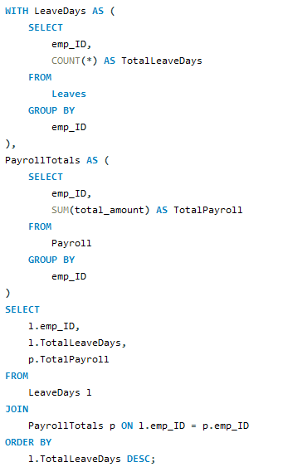
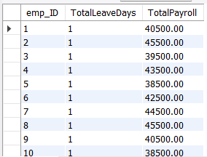
17. How do leave days correlate with payroll amounts?

Slide 25
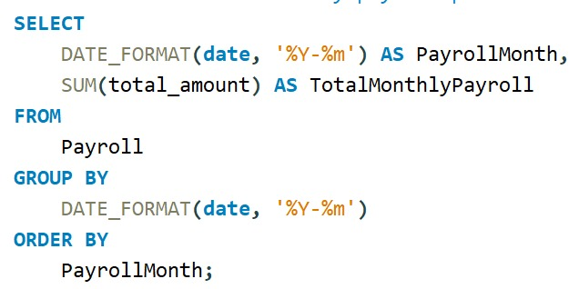

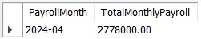
18. What is the total monthly payroll processed?

Slide 26

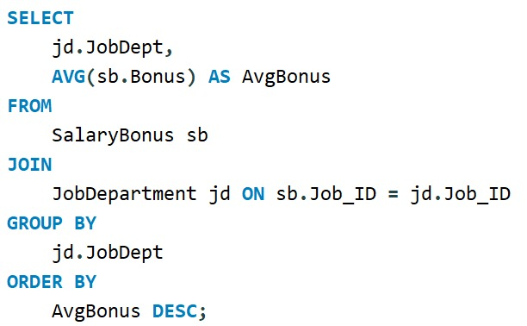
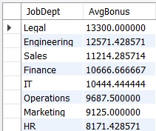
19. What is the average bonus given per department?

Slide 27

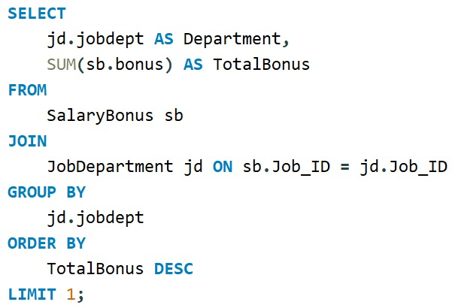
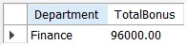
20. Which department receives the highest total bonuses?

Slide 28
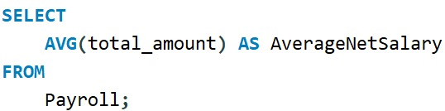

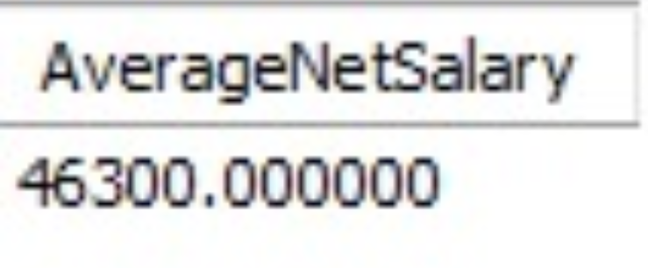
21. What is the average net salary after all deductions?

Slide 29
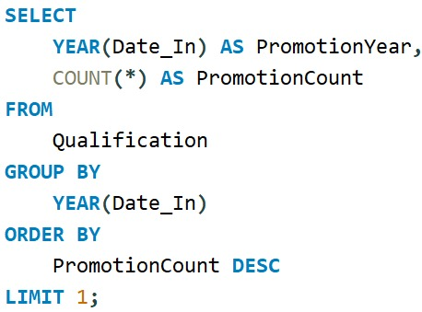


22. Which year had the highest number of employee promotions?

Slide 30
CONCLUSION :
The EMS efficiently integrates employee, job, salary, leave, and qualification data in a centralized database.
It supports better HR decision-making through structured data and automated workflows.
SQL queries provide actionable insights for performance, payroll, and workforce management.
This project strengthens skills in database design, SQL querying, and data analysis for business operations.

Slide 31

THANK YOU

